Slide 1
HTML
Frames

Slide 2
HTML FRAMES
A framed page is actually made up of multiple HTML pages
A frame
Partitions a web browser window
Display multiple web documents simultaneously.

Slide 3
Creating frames
Tags
<FRAMESET> - divides the screen into ROWS or COLS.
<FRAME> elements, one per division of the browser window.
Note: Because there is no BODY container, FRAMESET pages can't have background images and background colors associated with them.

Slide 4
Example
<HTML>
<HEAD>
<TITLE> Framed Page </TITLE>
<FRAMESET COLS=“23%,77%”>
<FRAME SRC=“Doc1.html”>
<FRAME SRC=“Doc2.html”>
</FRAMESET >
</HEAD>
</HTML>
FRAMESET COLS=”23%, 77%”
FRAME
NAME= left_pane
SRC=Doc1.html
FRAME
NAME=right_pane
SRC= Doc2.html

Slide 5
Attributes for <FRAMESET>
ROWS : Determines the size and number of rectangular rows within a <FRAMESET>.
COLS: Determines the size and number of rectangular columns within a <FRAMESET>,
FRAMEBORDER : Possible values 0, 1, YES, NO. A setting of zero will create a borderless frame.
FRAMESPACING: This attribute is specified in pixels. If you go to borderless frames you will need to set this value to zero as well, or you will have a gap between your frames where the border used to be.
BORDER(thickness of the Frame): This attribute specified in pixels. A setting of zero will create a borderless frame. Default value is 5.
BORDERCOLOR: This attribute is allows you choose a color for your border. This attribute is rarely used.

Slide 6
Attributes for <FRAME>
SRC: provides the URL for the page that will be displayed in the frame.
NAME: Required for frames that will allow targeting by other HTML documents. Works in conjunction with the target attribute of the <A>, <AREA>, <BASE>, and <FORM> tags.
MARGINWIDTH: Optional attribute stated in pixels. Determines horizontal space between the <FRAME> contents and the frame’s borders.
MARGINHEIGHT: Optional attribute stated in pixels. Determines vertical space between the <FRAME> contents and the frame’s borders.
SCROLLING: Displays a scroll bar(s) in the frame. Possible values are:
Yes – always display scroll bar(s).
No – never display scroll bar(s).
Auto – browser will decide based on frame contents.
By default: scrolling is auto.

Slide 7
What will be the output?
<HTML>
<HEAD> </HEAD>
<frameset rows=“25%, *, 25%”>
<frame src=“” >
<frameset cols=“25%, *”>
<frame src=“”>
<frame src=“” >
</frameset>
<frame src=“” >
</frameset>
</HTML>

Slide 8
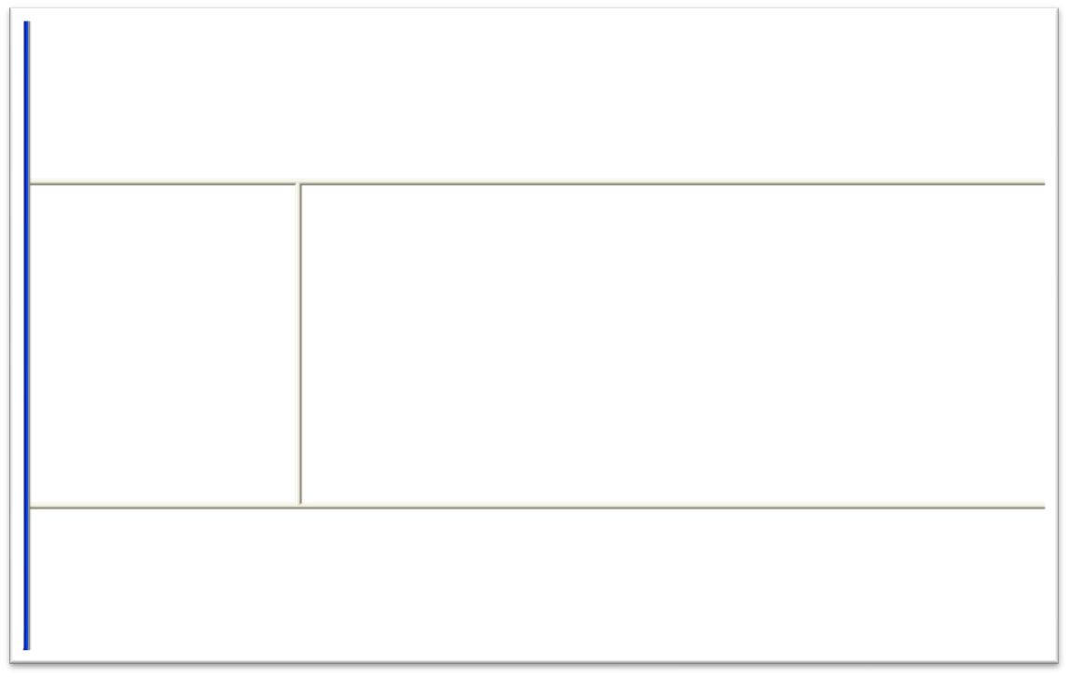

Slide 9
Frame Formatting
Example:
<frameset rows=“20%, *, 20%”>
<frame src=“header.html” noresize scrolling=no>
<frame src=“body.html”>
<frame src=“navigationbar.html” noresize scrolling=no>
</frameset>
9

Slide 10
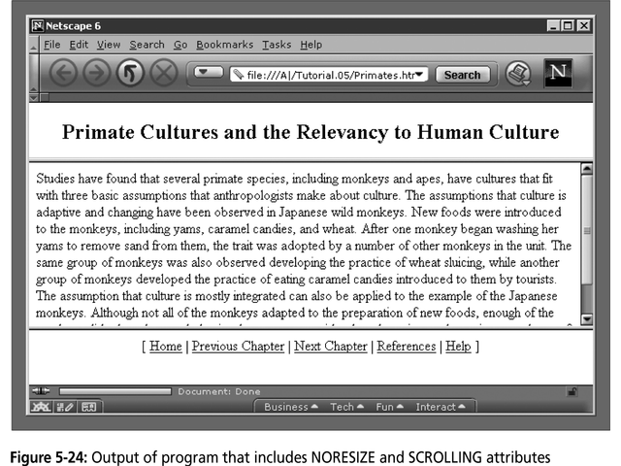
10

Slide 11
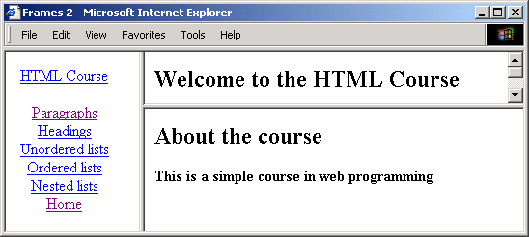
Nested framesets
<html>
<head><title>Frames 2</title></head>
<frameset cols="140,*">
<frame name=“mainF" src="navigation.html">
<frameset rows="30%,70%">
<frame name="upperF" src="intro.html">
<frame name="lowerF" src="course.html">
</frameset>
</frameset>
</html>

Slide 12
navigation.html
The anchor tag has a target attribute
takes the name of the frame used to display the information
All anchors below are targeted to the "mainF" frame
<html><head><title>Navigation Bar</title></head>
<body><center>
<a href="course.html" target="mainF">HTML Course</a><br><br>
<a href="paragraph.html" target="mainF">Paragraphs</a><br>
<a href="headings.html" target="mainF">Headings</a><br>
<a href="ulists.html" target="mainF">Unordered lists</a><br>
<a href="olists.html" target="mainF">Ordered lists</a><br>
<a href="nlists.html" target="mainF">Nested lists</a><br>
<a href="intro.html" target="mainF">Home</a><br>
</center></body>
</html>

Slide 13
Target _self
_blank
“frame name”

Slide 14
Noframes
Some browsers cannot process frames. Alternative content should be provided using the noframes element
<html>
<head><title>Frames 1</title></head>
<frameset cols="140,*">
<frame name="navF" src="navigation.html">
<frame name="mainF" src="intro.html">
</frameset>
<noframes>
<body>
Something here for browsers not supporting frames
</body>
</noframes>
</html>

